Slide 1

CEP 613
Telecommunication in Education
This page is Under construction
WebQuest on
Searching in the WWW
Presented By
www.Mokter.5u.com

Slide 2
Searching in the www
Outline
1. Searching in the www
2. Types of Search Tools
3. List of Some Popular Search Sites
4. How search engines work?
5. Successful Search Techniques
6. Using Advanced Search Options
7. Limiting the Search using More Options
8. Tips for Effective Searching
9. When search not found
10. References
11. Questions and Answers

Slide 3
Searching in the www
1. Searching in the www
Searching in the www means the thorough out examine something in order to find its location or details. There are billions of web pages in the Internet. So it is important to know how to find out relevant information very quickly and efficiently.
This short version of presentation will show how to do the effective search in briefly.

Slide 4
Searching in the www
2. Types of Search Tools
The two most common search tools are:
  Search Engines, and
  Subject Directories
a) Search Engine
A search engine is a specific type of search tool or device that allows the user to quickly find out web sites, web pages, and Internet files that match one or more keywords entered.
b) Subject Directories
A subject directory is a type of search tool that allows users to navigate of areas of interest without having to enter keywords.

Slide 5
Searching in the www
3. List of Some Popular Search Sites
Search Sites | URL
AltaVista | http://www.altavista.com
AOL Search | http://search.aol.com
Ask | http://www.ask.com
Google | http://www.google.com
MSN Search | http://search.msn.com
Netscape Search | http://search.netscape.com
Yahoo! | http://www.yahoo.com
Table-1: List of some popular search sites
Following table consists a list of some popular search sites and their URLs where both search engines and subject directories can be used to search the web.

Slide 6
Searching in the www
4. How search engines work?
  Search engines are based on computer programs that explore the Net in search of web pages, look for simple word matches, a series of words, or an entire phrase.
  Search engines do not actually search the entire Internet. Instead, they search an index or database of Internet sites.
  Search engine companies continuously update their databases by adding new contents regularly.

Slide 7
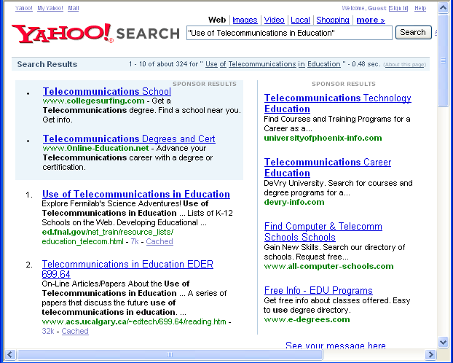
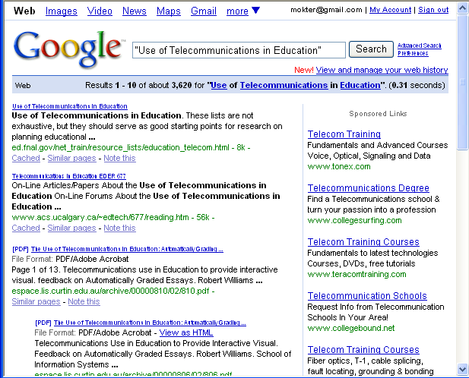
Searching in the www
Different results for the same search in different search engines?
Yes.
Since all search engines work in different fashion in their own databases, so the same search using different engines usually yields different results.
Figure-1: Results for the same search in two different search engines.

Slide 8
Searching in the www
Successful Search Techniques
Successful searching in the www involves following two key steps:
Briefly describing the keywords of the desired information, and
Using the brief description to display links to pages containing the desired information.
5.1 Web Searching using Search Engine
The following example illustrates the use of Google Search Engine to search for the keyword “Use of Telecommunications in Education”

Slide 9
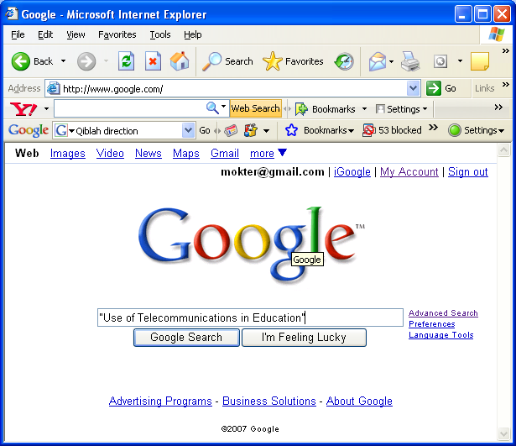
Searching in the www
5.1 Web Searching using Search Engine (Contd… )
Start your web browser (e.g. Internet Explorer), and then enter the URL www.google.com in its address Bar.
When the Google home page appears, type “Use of Telecommunications in Education” in the search text box, as shown in figure-2.
Figure-2: Google Search Engine Homepage

Slide 10
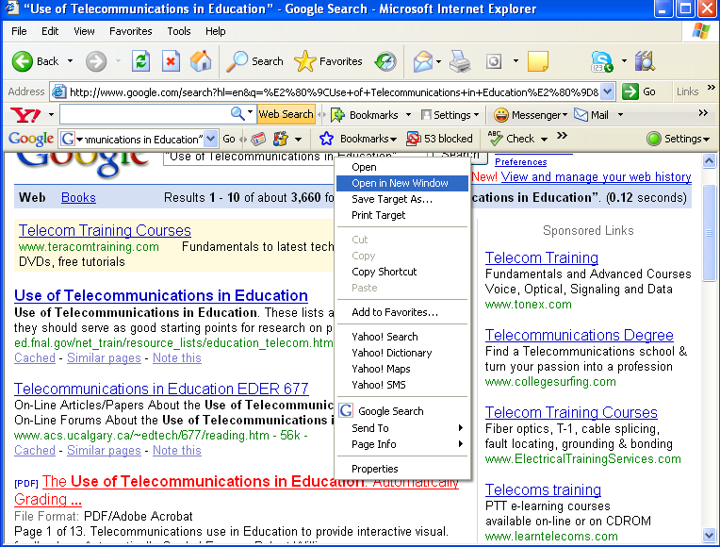
Searching in the www
5.1 Web Searching using Search Engine (Contd… )
3. Click on the Google Search button. When the search result is displayed, which shows that there are about 3,660 links in the www containing the phrase “Use of Telecommunications in Education”.
4. From all of the result pages you can open as many pages as you need by clicking Right mouse button, and selecting Open in New Window from pop-up menu, as shown in figure-3.
Figure-3: Google Search Engine result page

Slide 11
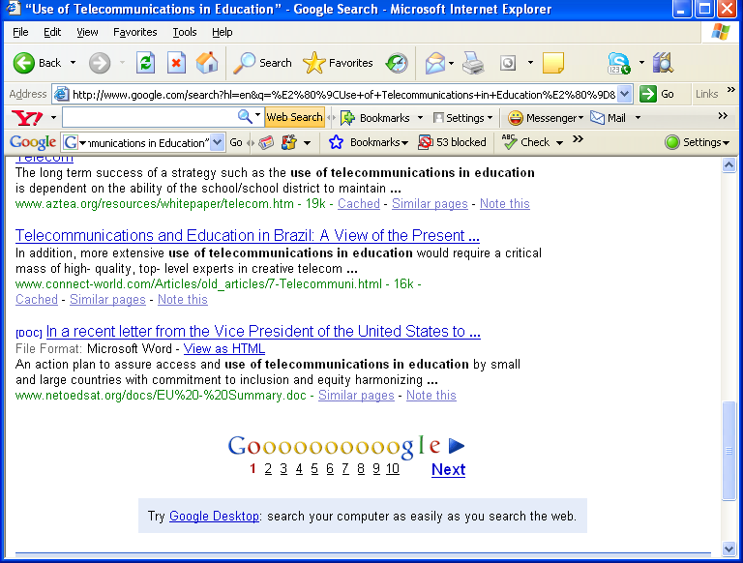
Searching in the www
5.1 Web Searching using Search Engine (Contd… )
5. If you need to open more links not shown in the first page of search window, scroll it to the bottom of the page as shown in figure-4. You can do it easily just clicking on the links 2, 3, 4, …, 9, or Next.
Figure-4: Google search engine result page scroll down position

Slide 12
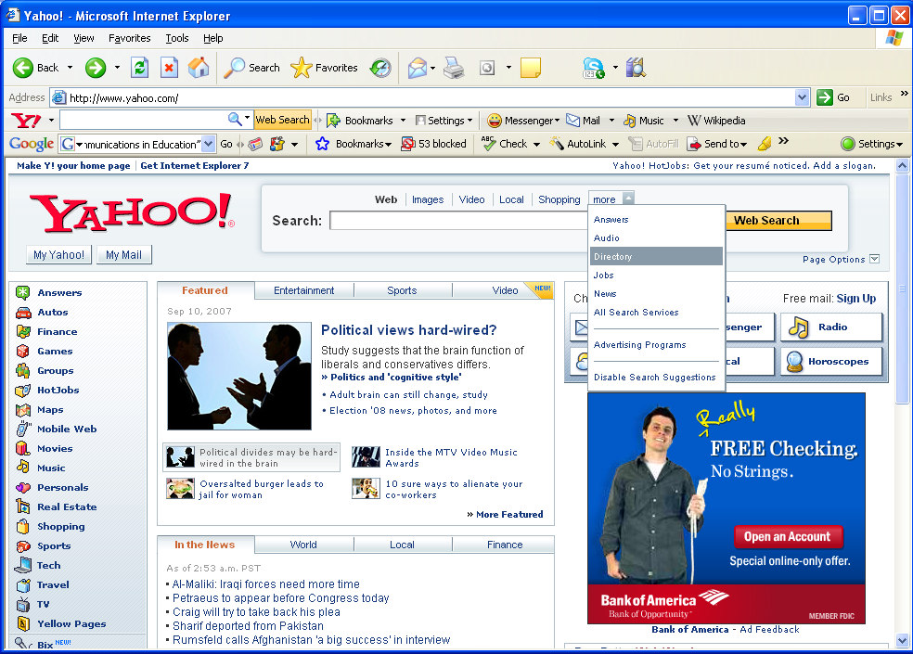
Searching in the www
5.2 Web Searching Using Subject Directory
The following example illustrates the use of Yahoo! Subject Directory to search for the keyword “Use of Telecommunications in Education”
Start the Internet Explorer, and then enter the URLwww.yahoo.com in its address Bar.
When the Yahoo home page appears, click on the more link located at the middle position of the page, as shown if figure 5.
Figure-5: Yahoo! Homepage More Option

Slide 13
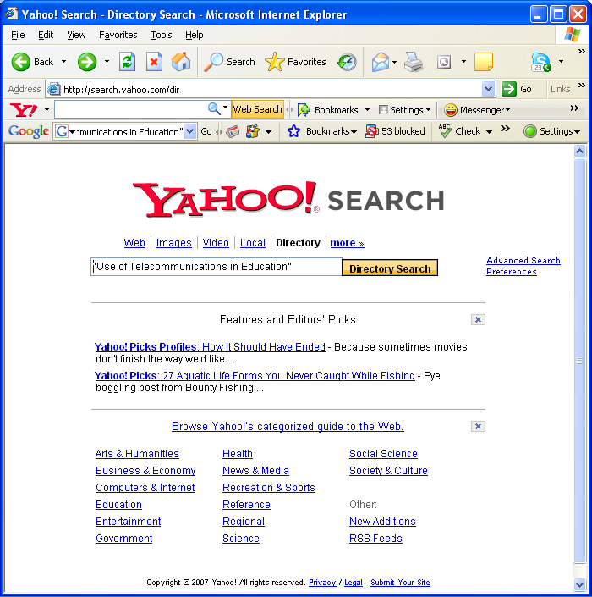
Searching in the www
5.2 Web Searching Using Subject Directory (Contd…)
3. A pop-up menu will appear on the screen, from this click on the Directory menu. Yahoo! Directory search page will appear on the screen.
4. When the Yahoo! Directory page appears, type “Use of Telecommunications in Education” in the search text box, and as shown on the figure-6.
Figure-6: Yahoo! Subject Directory Homepage

Slide 14
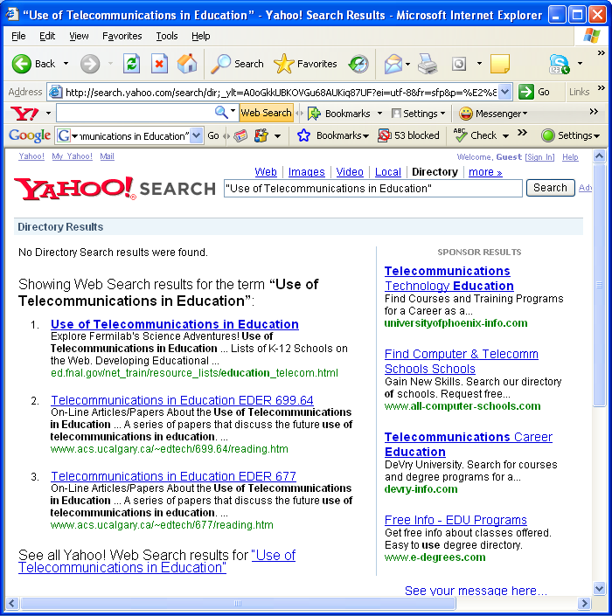
Searching in the www
5.2 Web Searching Using Subject Directory (Contd…)
5. Click on the Directory Search button. When the search result is displayed, it will show that No Directory Search result were found, but it will show some web search results pages from which you can open one ore more link page(s), as shown in figure-7.
Figure-7: Yahoo! Subject Directory search result

Slide 15
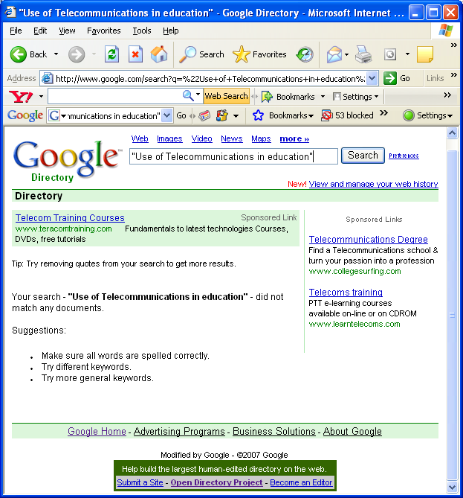
Searching in the www
5.2 Web Searching Using Subject Directory (Contd…)
Obviously, web searching using Subject Directories is really complicated tasks, and may not match any search link, so recommended only for advanced users only.
The following figure shows that the subject directory searching using the Google Directory search did not match any document for the keyword “Use of Telecommunications in Education” as shown in figure-8.
Figure-8: No search result in Google Subject Directory!

Slide 16
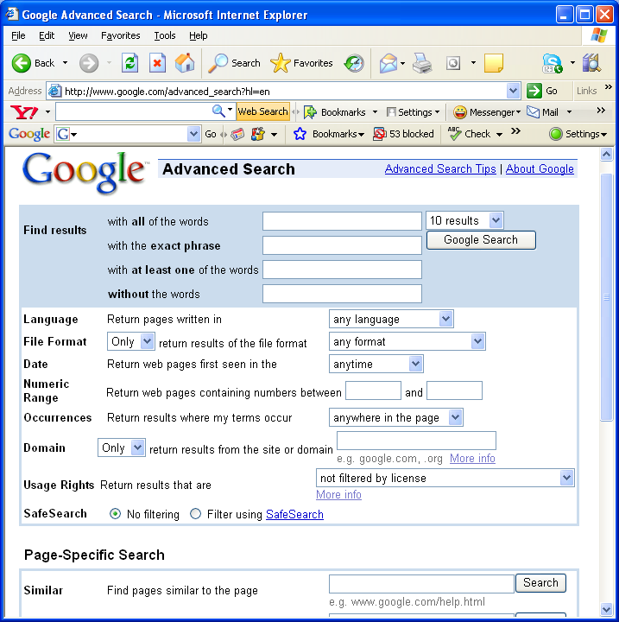
Searching in the www
6. Using Advanced Search Options
There are also options for limiting the search using advanced search. Here is the Google Advanced Search Page at www.google.com/advanced_search, as shown in figure-9.
By filling in all the fields in this page you can build quite complex queries.
Each “filter” we apply will narrow down our search and return fewer results.
You may also select pages written in a particular language, like Chaina or French.
Figure-9: Google advanced search page

Slide 17
Searching in the www
7. Limiting the Search using More Options
Here is a list of some common operators, commands, and specific characters that may be used to limit, refine and expedite search.
Category | Operator | Example | Description
Boolean Operators | AND Or, (+) | Art AND Music pizza + pepperoni + ham | Required both words to be in the page. i.e. must be present
 | OR | pepperoni OR chicken | Required either of words to be in the page. i.e. may be present
 | AND NOT Or, ( – ) | pizza + pepperoni + ham – garlic | Excludes pages with the word following AND NOT. i.e. must not be present
Parentheses | () | Physics AND (Relativity OR Einstein) | Parentheses group portions of Boolean Operators together. i.e. search for the complete phrase.
Phrase Searching | “ “ | “Use of Telecommunications in Education” | Requires the exact phrase within the quotation marks to be in the page.
Wildcard | * | Edu* | The * at the end of word substitutes for any combination of characters. Such as: Education, Educate, Educates, Educated, etc
Table-2: Some common Search Engine Math operators, commands, characters.

Slide 18
Searching in the www
8. Tips for Effective Searching
If you have a clear idea of what you are looking for, use a search engine first.
Use nouns and objects as query words, and most important terms first.
Be as specific as possible. Try to avoid common terms like Internet or people, unless they are a part of a phrase.
Use at least two keywords in a query. More keywords will give you a smaller and more focused list of hits.
Be aware of alternate spellings or alternative words in various forms of English: (e.g. colour OR color)
Use quotation marks to create phrases to reduce the number of results. (e.g. "Use of Telecommunications in Education”)

Slide 19
Searching in the www
8. Tips for Effective Searching (Contd…)
7. Type keywords in lower cases to find both lowercase and uppercase variations. But in case of proper noun use the uppercase character within quotation marks. (e.g. “Charles Babbage”)
8. Use uppercase characters for Boolean operators to differentiate those from the words (e.g. “Information” AND “Technology in Education”).
9. Do not make your queries too complicated.
10. If you do not find what you are looking for, then check your spelling and check it again… or search for synonyms.
11. If your search is unsuccessful with one search engine, read its help or try with another search engine.

Slide 20
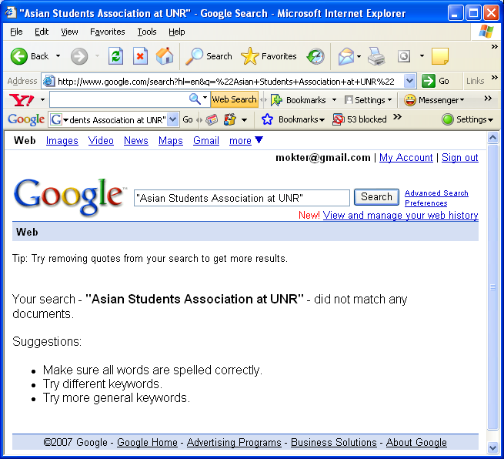
Searching in the www
9. When search not found
If your browser is unable to locate the server, the search tool shows a error message like one of the followings:
Your search phrase did not match any documents, or
"Document not found", or
"404 not found“
Figure-10: Search not found by Google Search Engine

Slide 21
Searching in the www
9. When search not found (Contd…)
In this case do not despair! Try with another search engine(s).
The message doesn’t confirm that the site doesn’t exist; rather the webpage may still exist but not uploaded in the search engine database.
However, it could mean that the server may be down for maintenance or that the network is busy.

Slide 22
Searching in the www
10. References
Teachers Discovering Computer Integrating Technology and Digital Media in the Classroom; By Shelly, Cashman, Gunter and Gunter, Fourth Edition, Thomson Course Technology 2006, pp 87, 132-140.
2. https://webct6.unr.edu/webct/urw/lc4130011.tp0/cobaltMainFrame.dowebct
3. http://www.pandia.com/goalgetter/index.html
4. http://www.google.com
5. http://www.yahoo.com

Slide 23
Searching in the www
11. Questions and Answers

Slide 24
Searching in the www
Thank You

